Slide 1
PGL: Barton hall 8th – 12th July 24
Parent Meeting: 25.3.24 A.Sissons

Slide 2
Staffing
Current plan:
Mrs Sissons (all week)
Mr Davies (Mon-Wed) / Mr Jones (Wed-Fri)

Slide 3
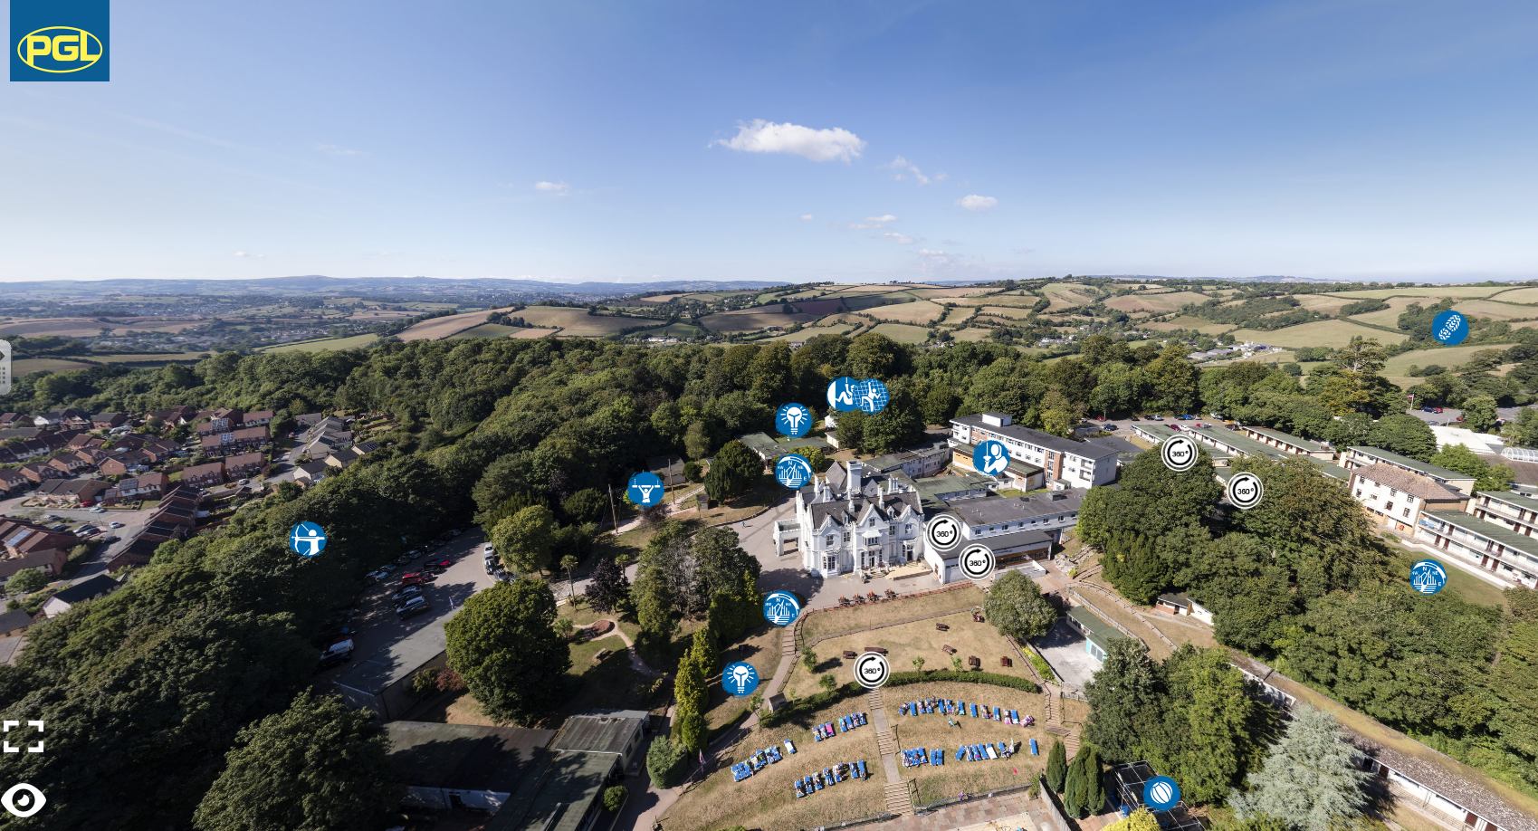

Slide 4
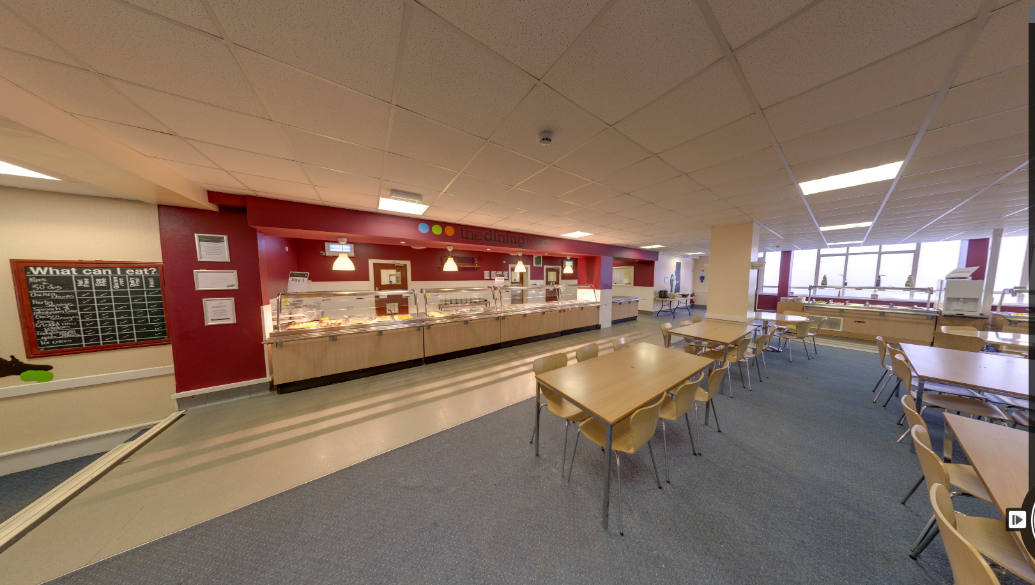

Slide 5
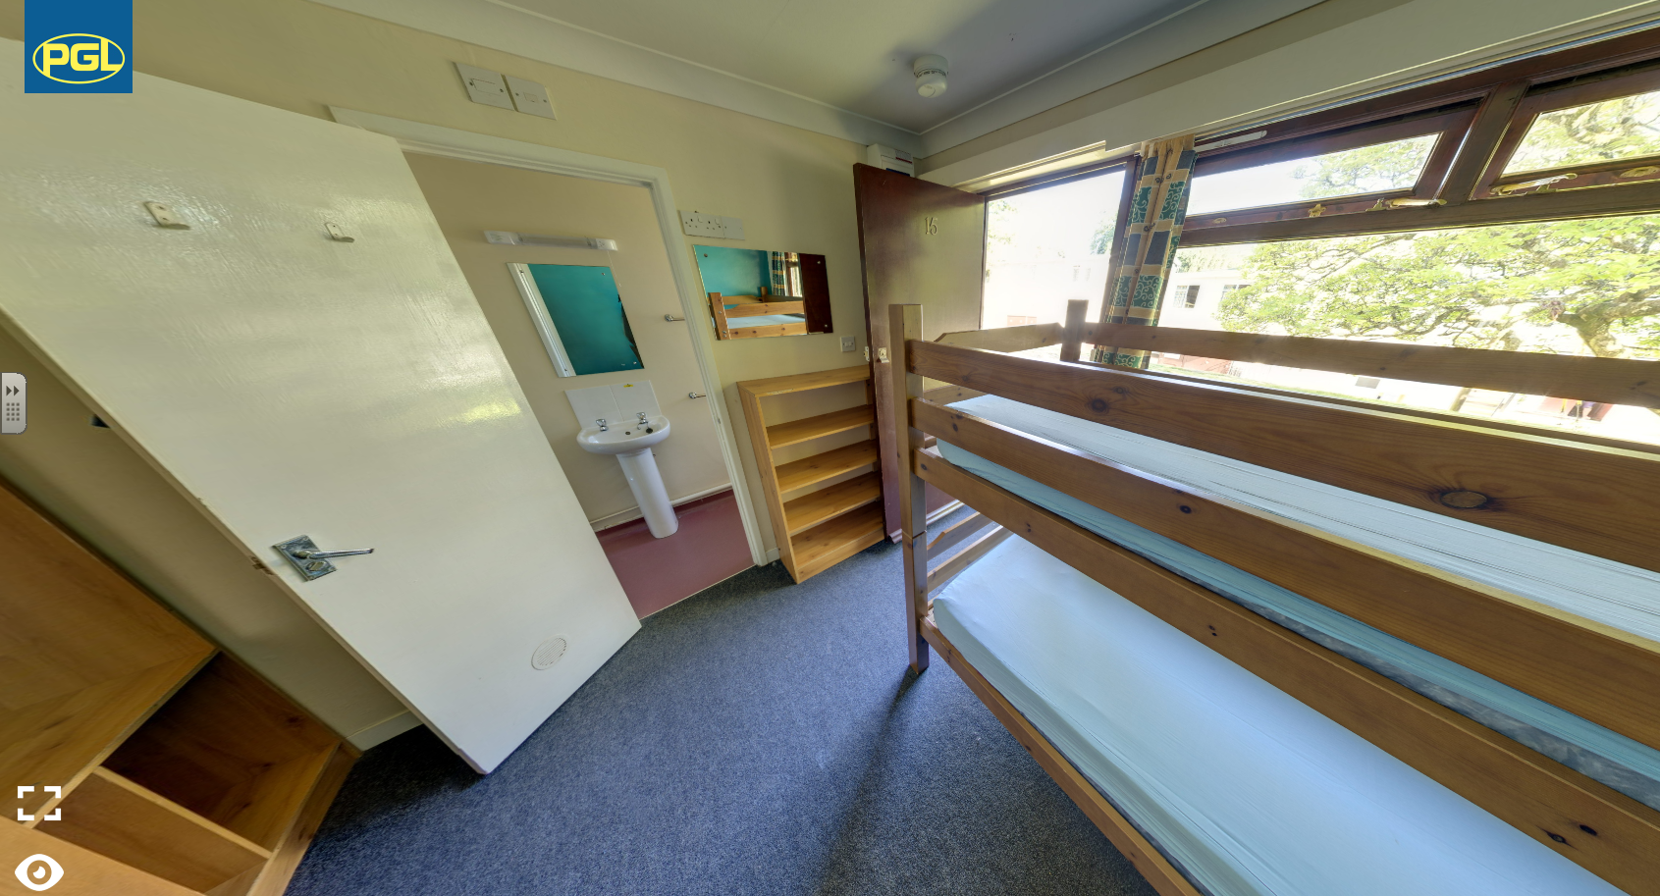
Room allocation:
Single gender
Rooms sleep 4 to 10
Children choose 1st and 2nd choice room mate

Slide 6
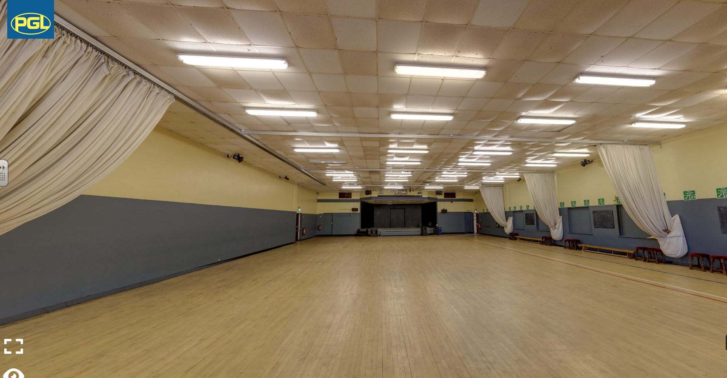

Slide 7
Barton Hall Adventure Centre, Devon - Primary School Trips (pgl.co.uk)
OR
Pensilva School Website
Gallery Page Barton Hall 2023

Slide 8
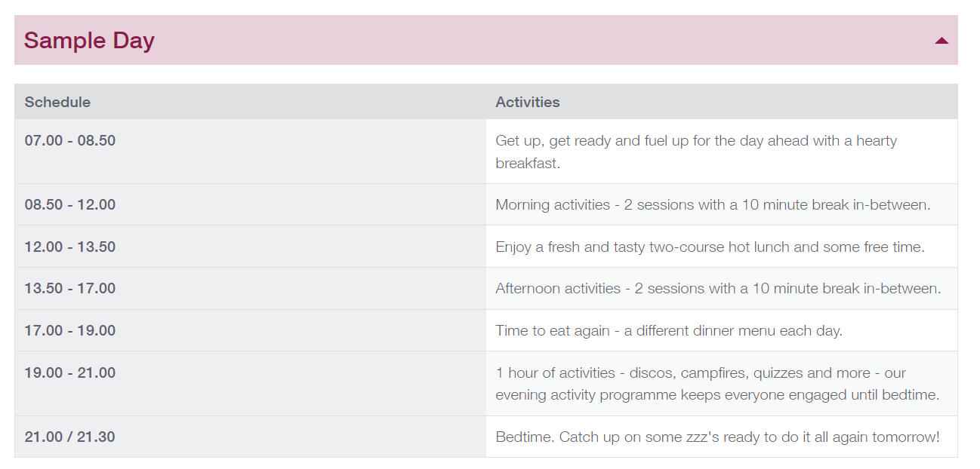
Provisional Activity Programme:
Arrive at school: 9am (Take bags to hall) Aiming to depart school at: 10.00
Monday: Settling in accommodation
Meeting PGL group leader
Sports
Evening Activity 19.30 – 21.00
Friday: Session 1 9.00 – 10.30
Session 2 10.40 – 12.10
Depart 1.30

Slide 10
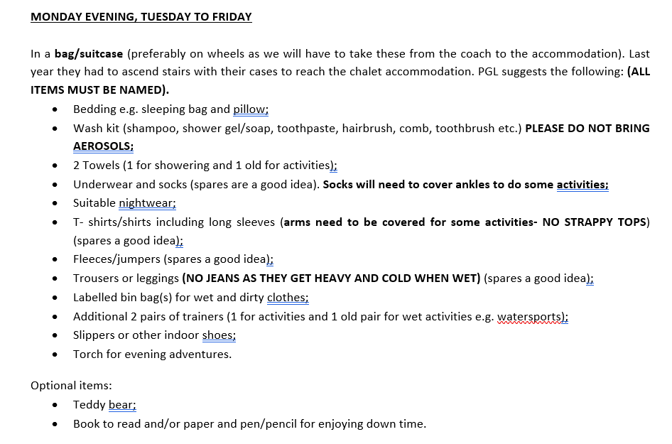

Slide 12
Medical, information and dietary forms will need to be completed shortly before travel.
It is essential that they contain everything including previously supplied information and doctor/emergency contacts.
Any medications that need to be given (with full instructions) need to be brought in ideally on the Friday before we travel. If that is not possible, on the Monday morning.

Slide 13
Any questions?

